Slide 1
Digital Electronics
Adder, Subtractor, Multiplexor, Demultiplexer

Slide 2
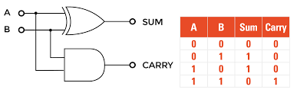
Half adder
SUM = A ⊕ B
CARRY = A.B

Slide 3
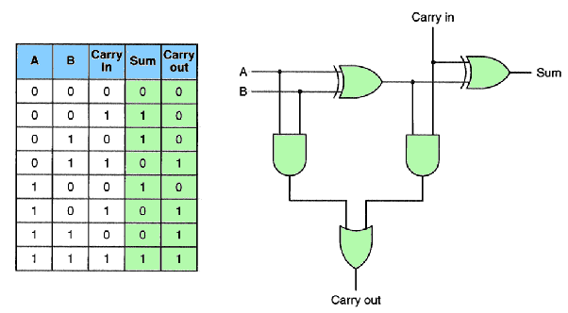
Full Adder
Sum = A ⊕ B ⊕ Cin
CARRY-OUT = A.B + Cin(A ⊕ B)
One full adder can be made using 2 half adders. Multibit adders are made using cascaded single bit full adders

Slide 4
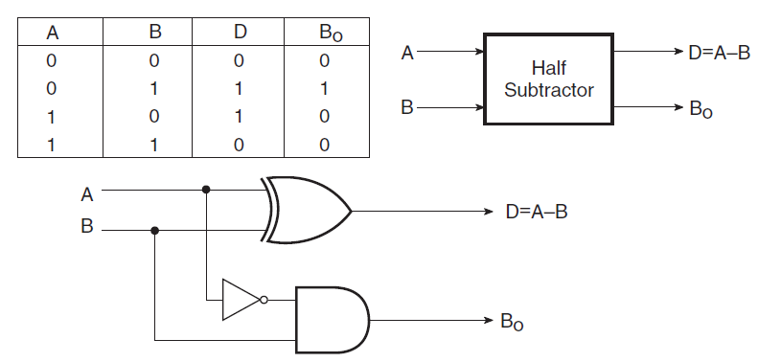
Half Subtractor
S = A ⊕ B
B_{o} = A’.B

Slide 5
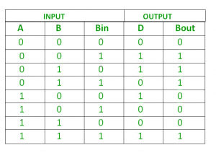
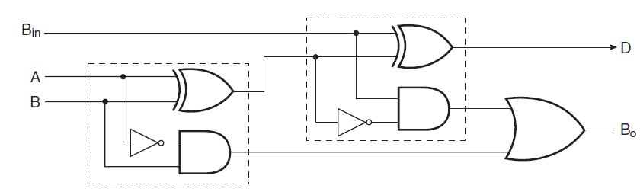
Full subtractor
Diff D = A ⊕ B ⊕ B_{in}
Borrow-Out B_{o} = A’.B + A’.B_{in} + B.B_{in}
One full subtractor can be made using 2 half subtractors, Multibit adders are made using cascaded single bit full adders

Slide 6
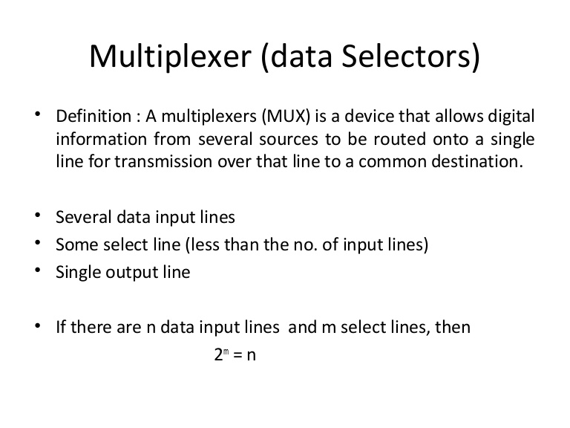
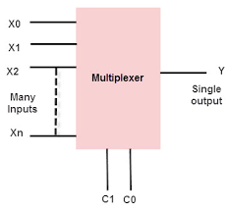
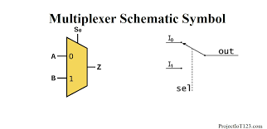
Multiplexer

Slide 7
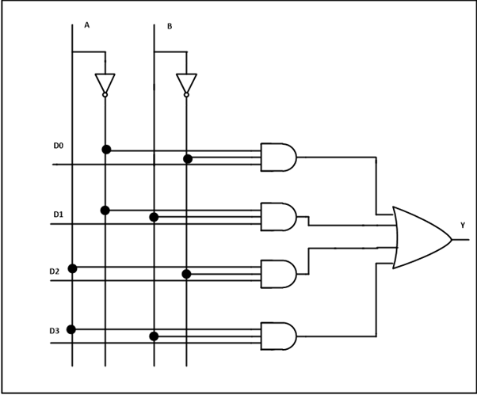
Multiplexer
4:1 Mux, selects one out of four lines.

Slide 8
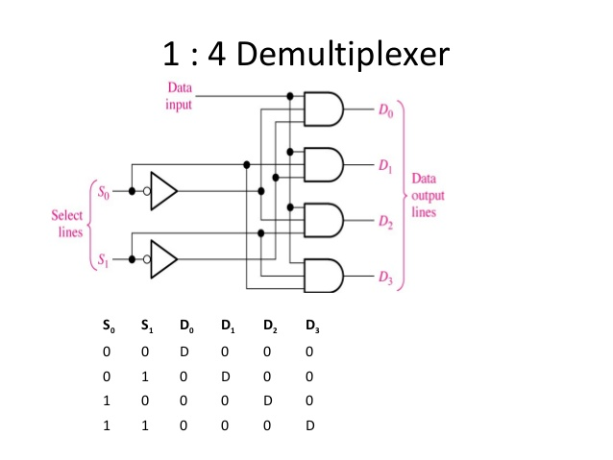
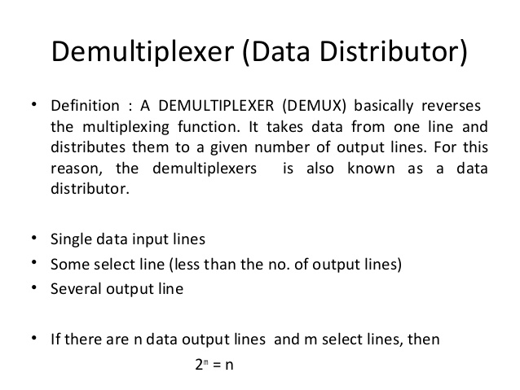
Demultiplexer

Slide 9
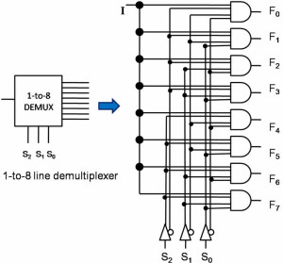
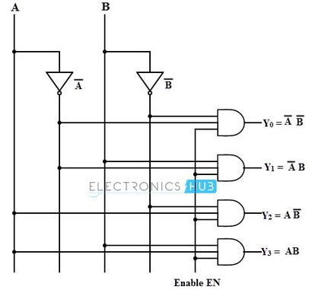
Demultiplexer
Decoder

Slide 10
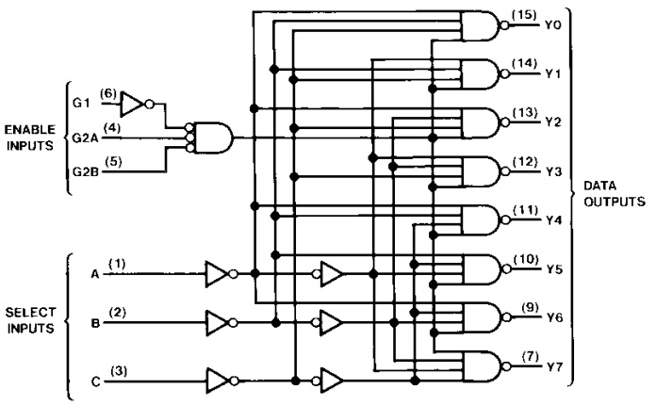
74138, 3:8 decoder

